Slide 1
Web application Geo presence tracker
Presenting by:- balakrishna kolla

Slide 2
content
01
introduction
02
How it’s work
03
Key features include
04
Screenshot of application
05
Reference

Slide 3
01
introduction
About Geo presence
Tracker

Slide 4
INTRODUCTION
Geo presence tracker, efficient task management, employee reporting,and attendance tracking are crucial for smooth operations and effective resource utilization. This abstract propose the development of a comprehensive web application tailored to meet these organizational needs.

Slide 5
The proposed web application offers a centralized platform for task allocation by administrators to employees, streamlined reporting mechanisms, and advanced attendance tracking functionalities leveraging GPS technology for both on-field and off-field employee

Slide 6
02
How it’s work

Slide 7
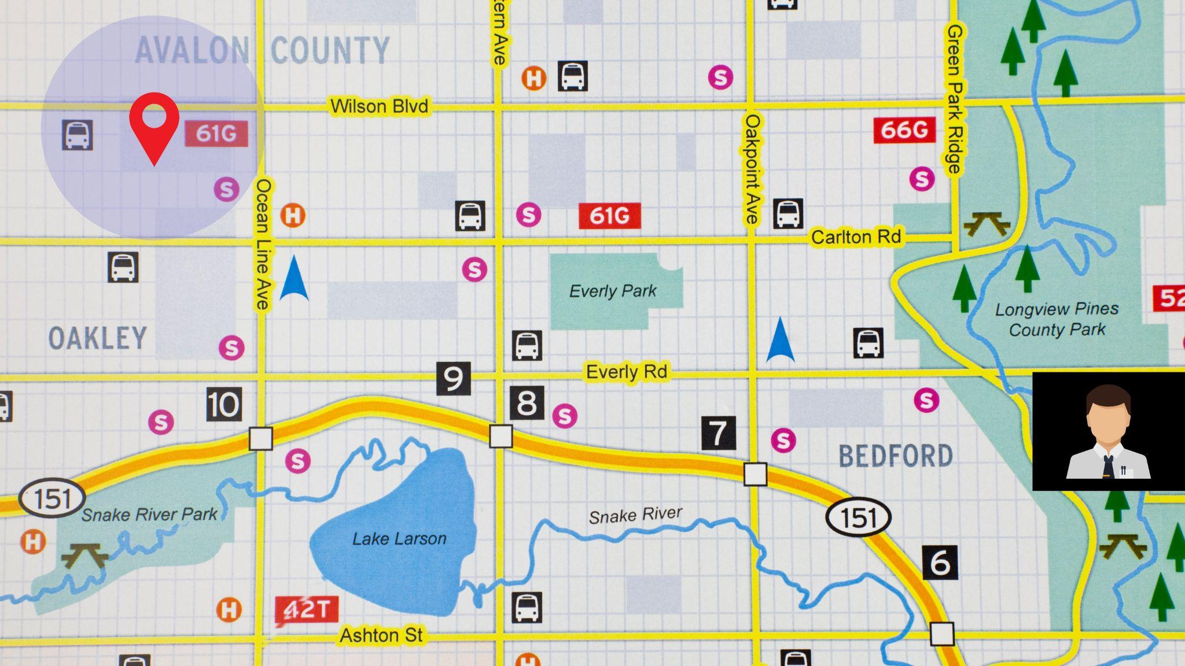
Working location
Assign by administration
employee

Slide 8
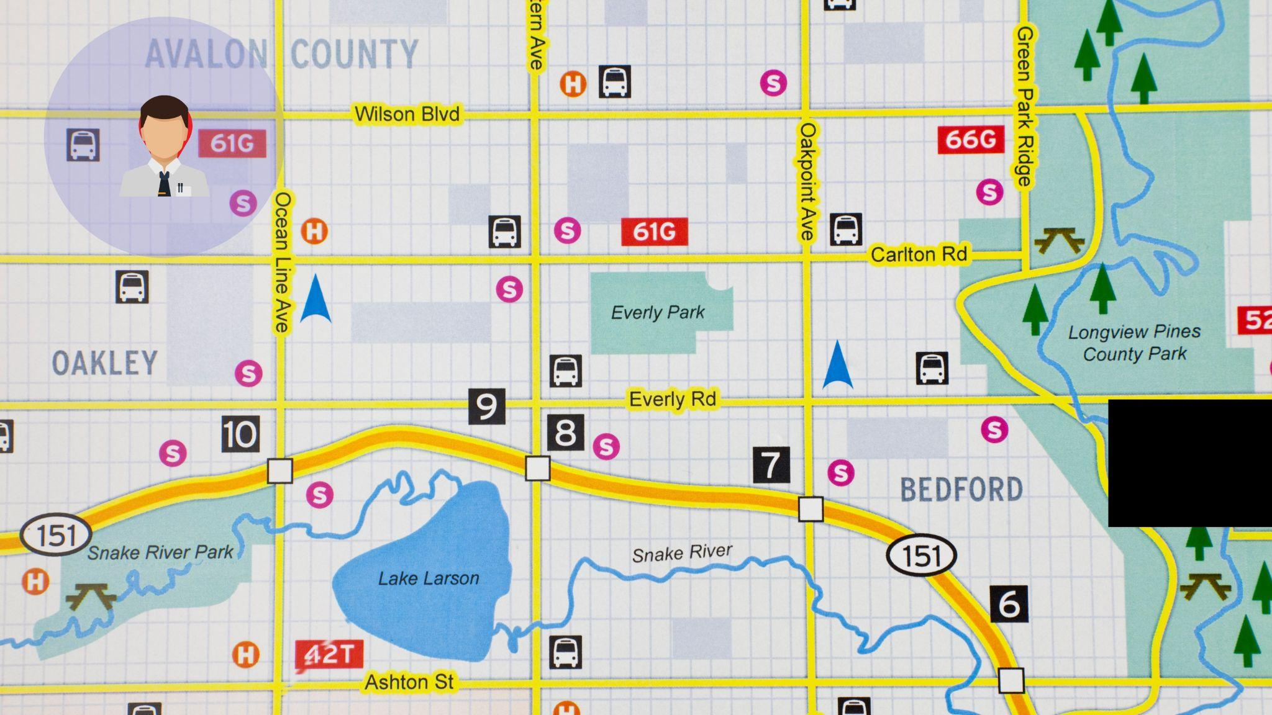
Working location
Assign by administration
employee

Slide 9
KEY FEATURES
TASK MANAGEMENT
EMPLOYEE
TRACKING
PAYROLL MANAGEMENT
ATTENDANCE TRACKING
GEO LOCATION
INTEGRATION

Slide 10
TASK MANAGEMENT
ADMINISTRATION CAN ASSIGN TASKS TO EMPLOYEES THROUGH THE WEB APPLICATION
TASK ARE CATEGORIZED WITH DETAILS INCLUDING PRIORITY, DEADLINES , AND DESCRIPTION.
EMPLOYEES RECEIVE TASK NOTIFICATION AND UPDATES IN REAL TIMES

Slide 11
EMPLOYEE TRACKING
EMPLOYEE CAN PROVIDE DETAILED REPORTS ON TASK DIAGNOSIS,PROBLEM DESC,AND PROPOSED SOLUTION THROUGH THE APPLICATION
REPORTING CAN INCLUDE MULTIMEDIA ATTACHMENTS SUCH AS IMAGES PR DOCUMENT
REPORTING INTERFACE FACILITATES

Slide 12
Attendance Tracking
The web application includes modules for recording employee in-time and out-time utlizing GPS for precise location tracking.
The system generates comprehensive reports on employee attendance pattern and working hours.
Working hours are automatically calculated based on attendance records

Slide 13
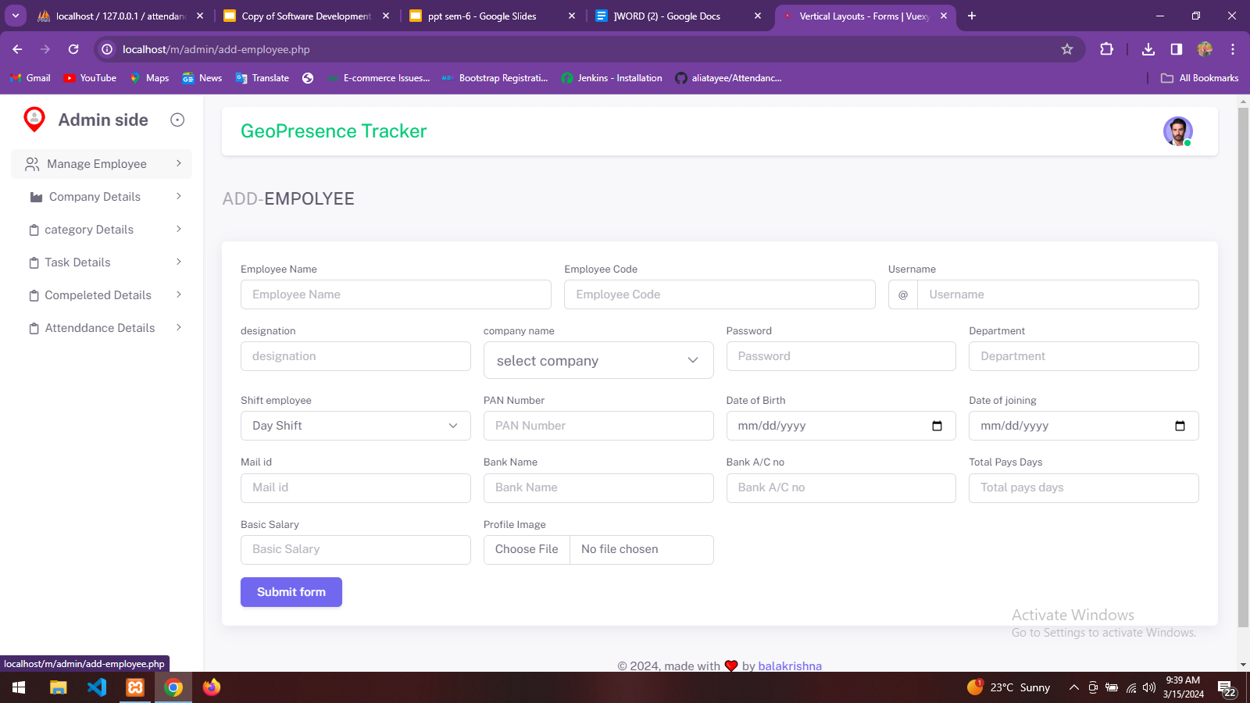

Slide 14
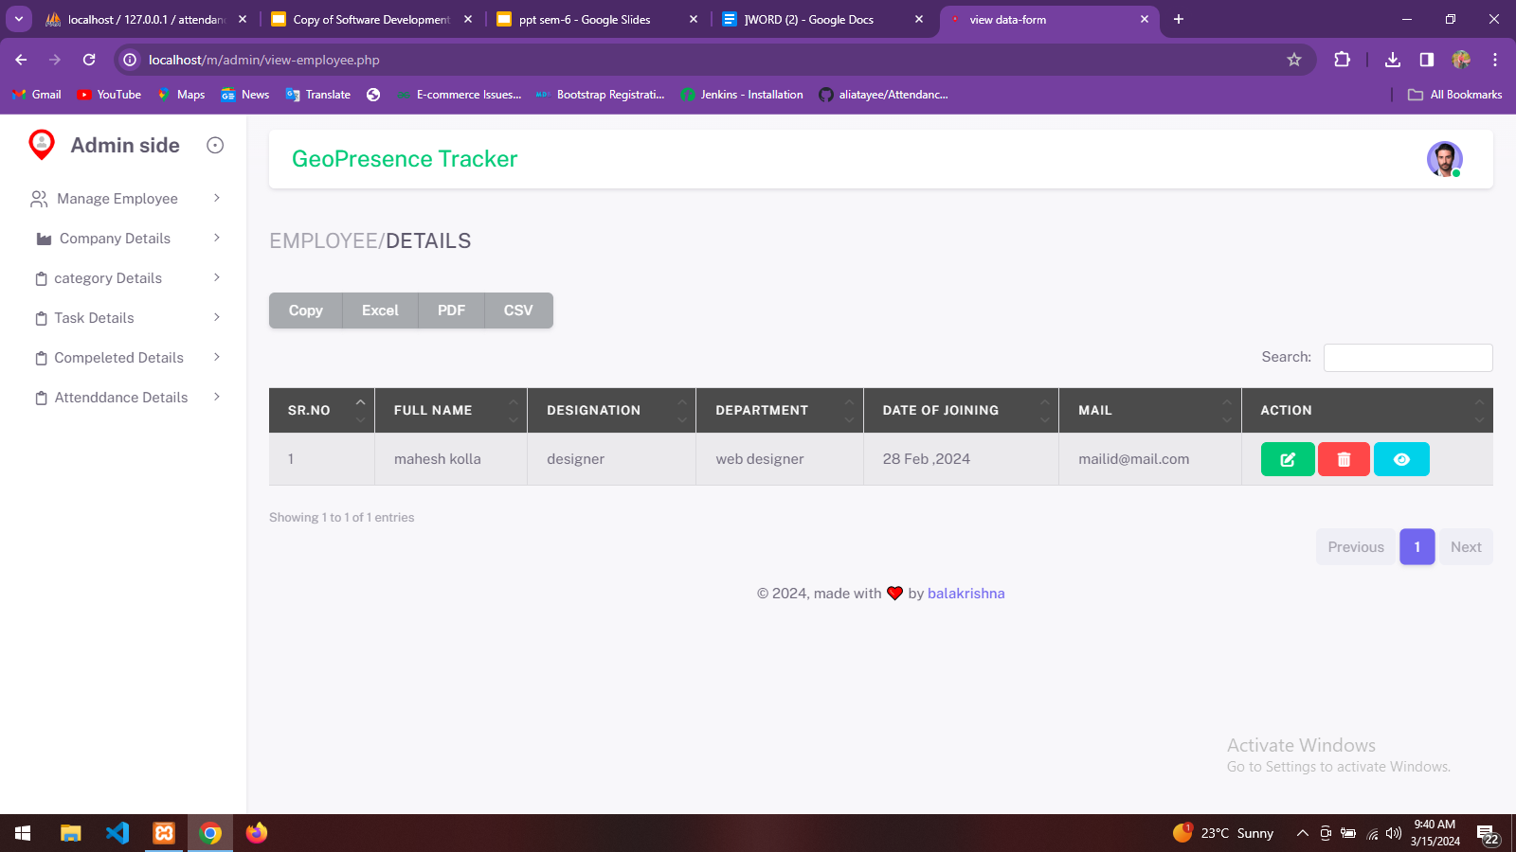

Slide 15
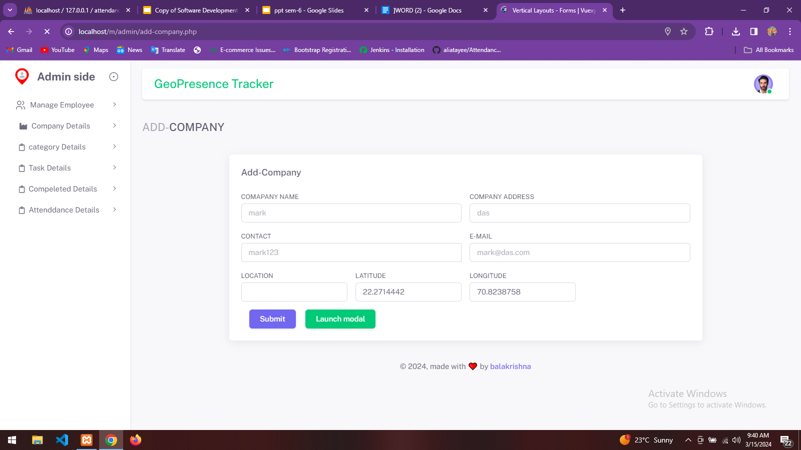
THE CURRICULUM
INTRODUCTION
Mercury is the closest planet to the Sun and the smallest one in System
2XXX | Jupiter is a big planet
2XXX | Earth is where all live
2XXX | Mars is a cold place
2XXX | Saturn has several rings
ADVANTAGES
75%
80%
95%
EARTH
VENUS
SATURN
FEATURES
55%
NEPTUNE
75%
MERCURY

Slide 16
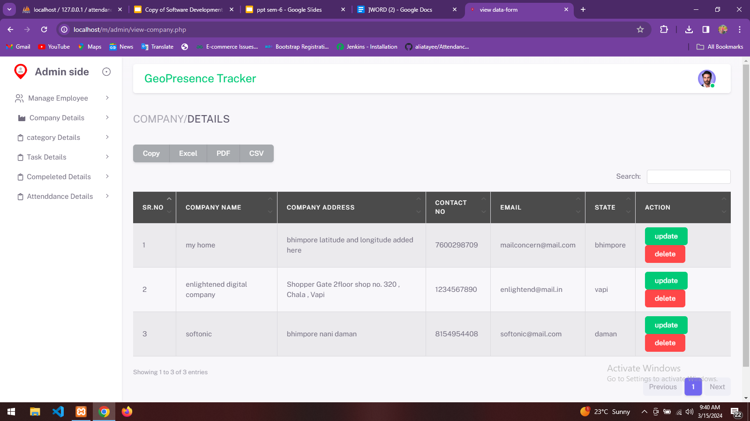
MISSION AND VISION
MISSION
VISION
Saturn is composed mostly of hydrogen and helium. It was named after the Roman god of wealth and agriculture
Venus has a beautiful name and is the second planet from the Sun. It’s terribly hot, even hotter than Mercury

Slide 17
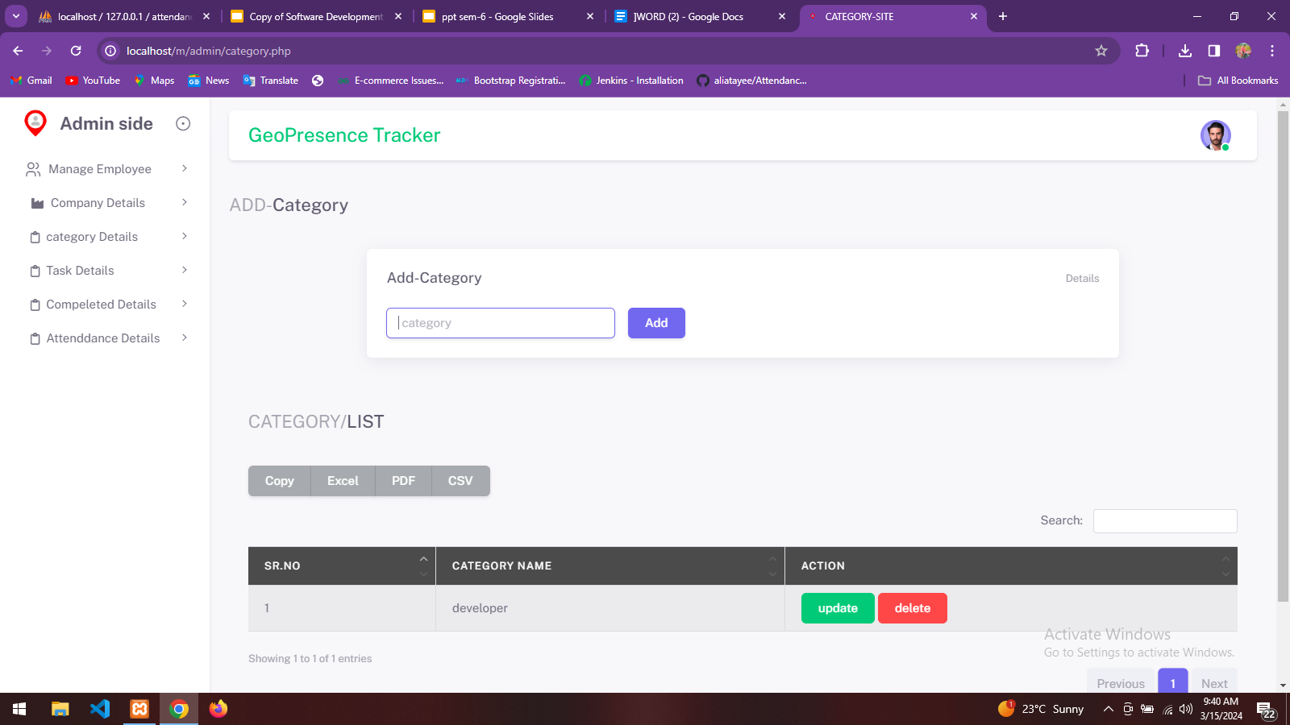
OUR VALUES
SATURN
EARTH
JUPITER
VENUS
Saturn is a gas giant and has several rings
Earth is the only planet that harbors life
Jupiter is the biggest planet of them all
Venus is the second planet from the Sun

Slide 18
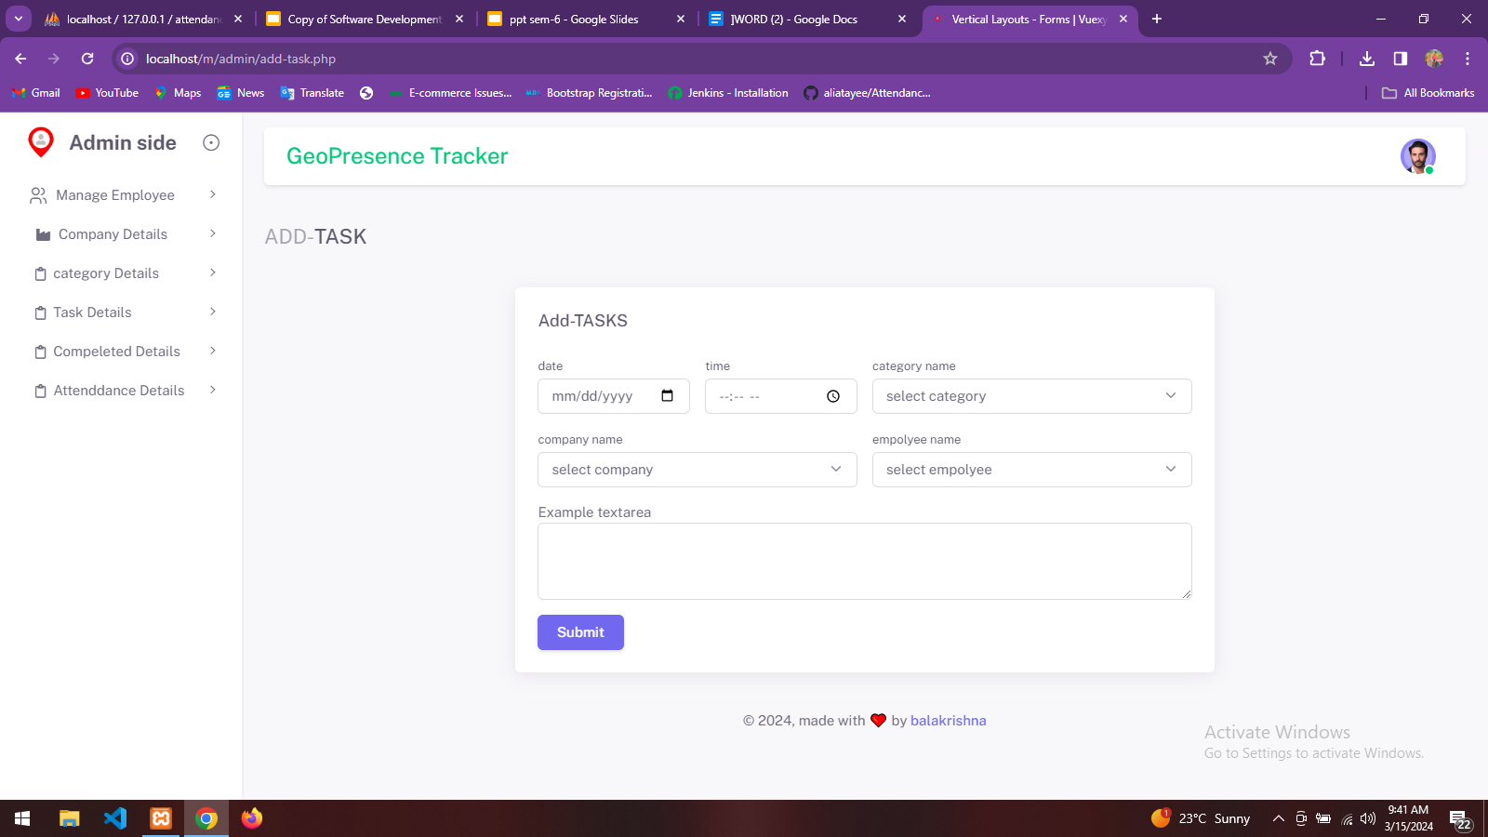
OUR SUCCESS
MERCURY
JUPITER
75%
90%
VENUS
SATURN
85%
95%
Mercury is the closest planet to the Sun
Jupiter is the biggest planet of them all
Venus is the second planet from the Sun
Saturn is a gas giant and has several rings

Slide 19
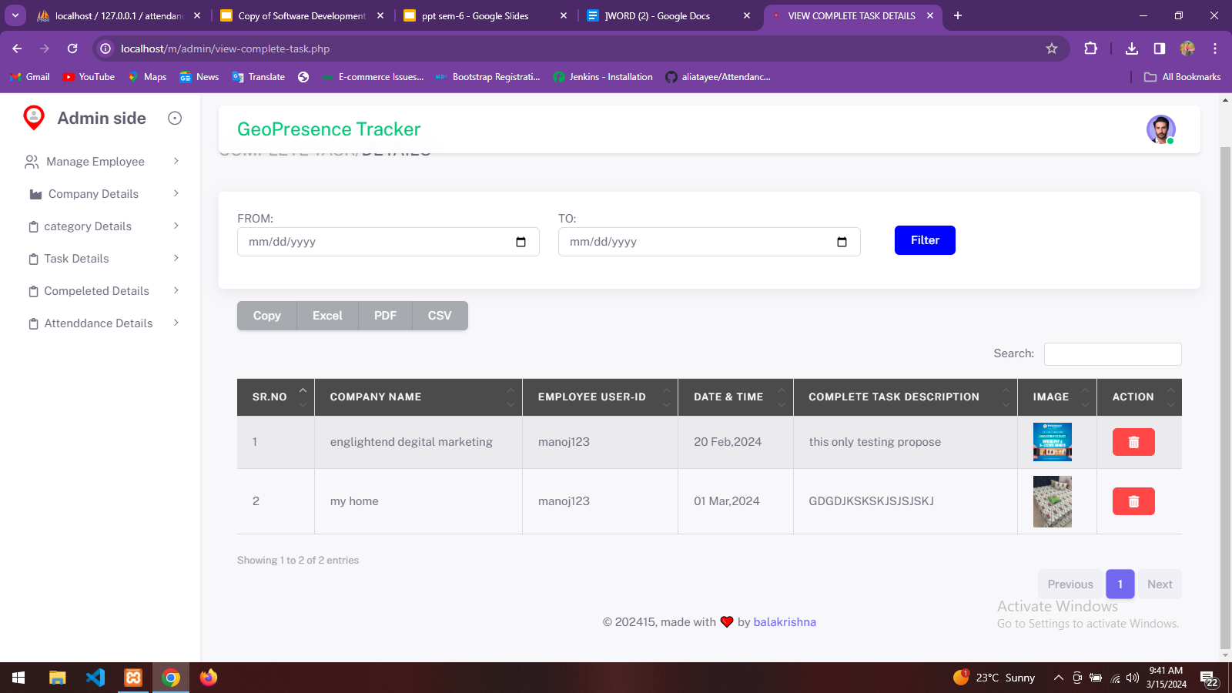
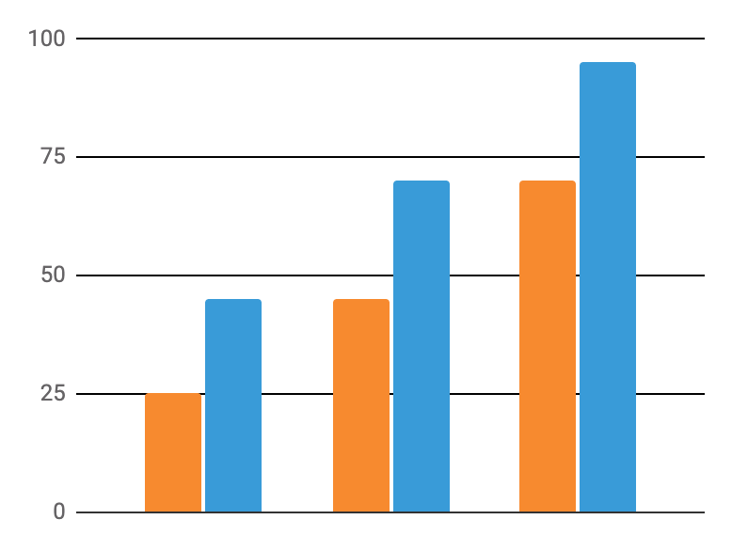
STATISTICS
VENUS
Venus is the second planet from the Sun
MARS
Despite being red, Mars is a cold place
Follow the link in the graph to modify its data and then paste the new one here. For more info, click here

Slide 20
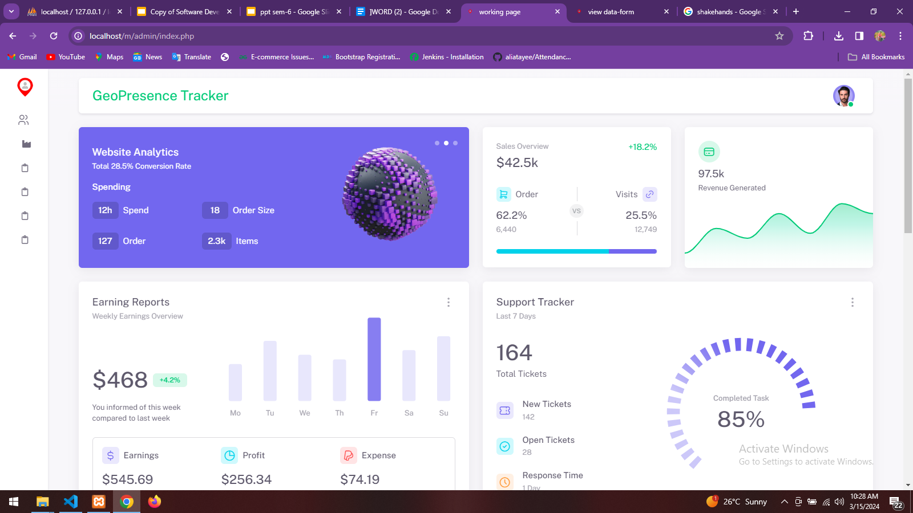

reference
youtube.com
w3school.com
geegforgeeks.com
php.com

Slide 21
THANKS!
Do you have any questions?
balakrishnakolla00014@gmail.com
+91 8866153687
http-bala.github.io

